Slide 1
“Household expenditures on gas, electricity, and water have been drastically increased in the year of 2020 because of the change of working styles and the residential consumption and commercial consumption are negatively correlated?” MDM4U ISP Blair Yang
Raw data available from:
Government of Canada, Statistics Canada. Supply and disposition of natural gas, monthly (data in thousands). Government of Canada, Statistics Canada; 2021. https://doi.org/10.25318/2510005501-eng
Government of Canada, Statistics Canada. Gross domestic product, expenditure-based, Canada, quarterly. Government of Canada, Statistics Canada; 2020 . https://doi.org/10.25318/3610010401-eng

Slide 2
Variables
Two choices of one-variable statistics
Variable 1 &2: Consumption of water, gas, electricity, and fuel
(I picked 4)
https://doi.org/10.25318/3610010401-eng
One pair of two-variable statistics
Variable 3&4: Commercial and residential consumption of natural gas
https://doi.org/10.25318/2510005501-eng

Slide 3
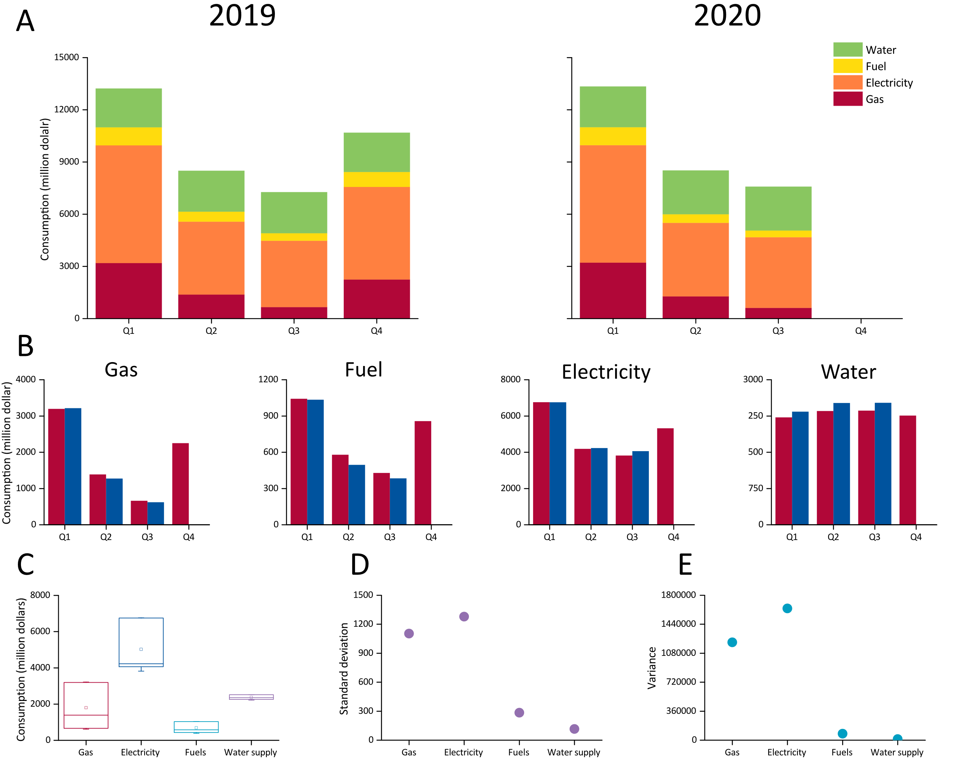
Figure 1: Consumption of gas, fuel, electricity, and water.
(A) The consumption of water, fuel, electricity, and gas by quartile in 2019 and 2020. (B) Comparison of the consumption of gas, fuel, electricity, and water between 2019 and 2020 by quartile. (C) Box chart of gas, electricity, fuels, and water by. The line between the box represents mean; the square represents median; the upper and the lower lines respectively represent Q3 and Q1; the short upper and lower line represent max and min, respectively. (D) Standard deviation of consumption of gas, fuel, electricity, and water in 2019 and 2020. (E) Variance of consumption of gas, fuel, electricity, and water in 2019 and 2020.
Government of Canada, Statistics Canada. Gross domestic product, expenditure-based, Canada, quarterly. Government of Canada, Statistics Canada; 2020.
https://doi.org/10.25318/3610010401-eng

Slide 4
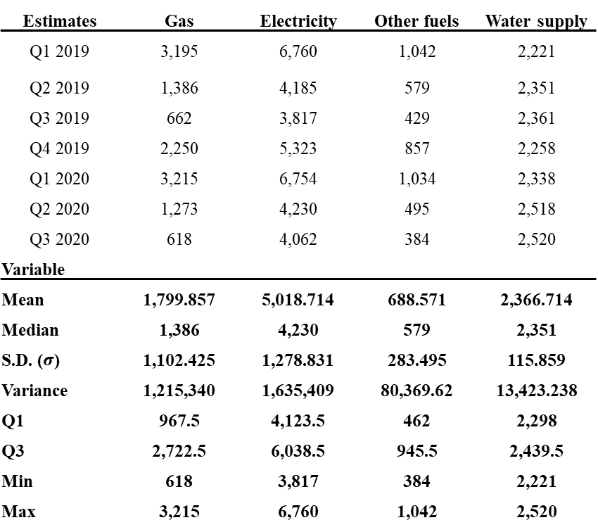
Data set for variable 1&2
https://docs.google.com/spreadsheets/d/1h0GzWDVsPXpuZUsmoUvX7nrYiI0L0nQkspOVKVJLRvg/edit?usp=sharing
Supply and disposition | Residential consumption | Commercial consumption
2019/9/1 | 450,832 | 552,474
2019/10/1 | 1,055,341 | 1,117,391
2019/11/1 | 1,910,612 | 1,776,750
2019/12/1 | 2,408,889 | 2,363,664
2020/1/1 | 2,651,548 | 2,562,649
2020/2/1 | 2,460,004 | 2,416,359
2020/3/1 | 2,053,383 | 2,070,085
2020/4/1 | 1,635,211 | 1,577,249
2020/5/1 | 926,900 | 910,937
2020/6/1 | 550,927 | 532,037
2020/7/1 | 416,827 | 428,191
2020/8/1 | 354,802 | 411,957
2020/9/1 | 515,523 | 523,627
2020/10/1 | 1,097,562 | 1,103,953
Estimates | Gas | Electricity | Other fuels | Water supply
Q1 2019 | 3,195 | 6,760 | 1,042 | 2,221
Q2 2019 | 1,386 | 4,185 | 579 | 2,351
Q3 2019 | 662 | 3,817 | 429 | 2,361
Q4 2019 | 2,250 | 5,323 | 857 | 2,258
Q1 2020 | 3,215 | 6,754 | 1,034 | 2,338
Q2 2020 | 1,273 | 4,230 | 495 | 2,518
Q3 2020 | 618 | 4,062 | 384 | 2,520
Variable
Mean | 1,799.857 | 5,018.714 | 688.571 | 2,366.714
Median | 1,386 | 4,230 | 579 | 2,351
S.D. ($σ$) | 1,102.425 | 1,278.831 | 283.495 | 115.859
Variance | 1,215,340 | 1,635,409 | 80,369.62 | 13,423.238
Q1 | 967.5 | 4,123.5 | 462 | 2,298
Q3 | 2,722.5 | 6,038.5 | 945.5 | 2,439.5
Min | 618 | 3,817 | 384 | 2,221
Max | 3,215 | 6,760 | 1,042 | 2,520

Slide 5
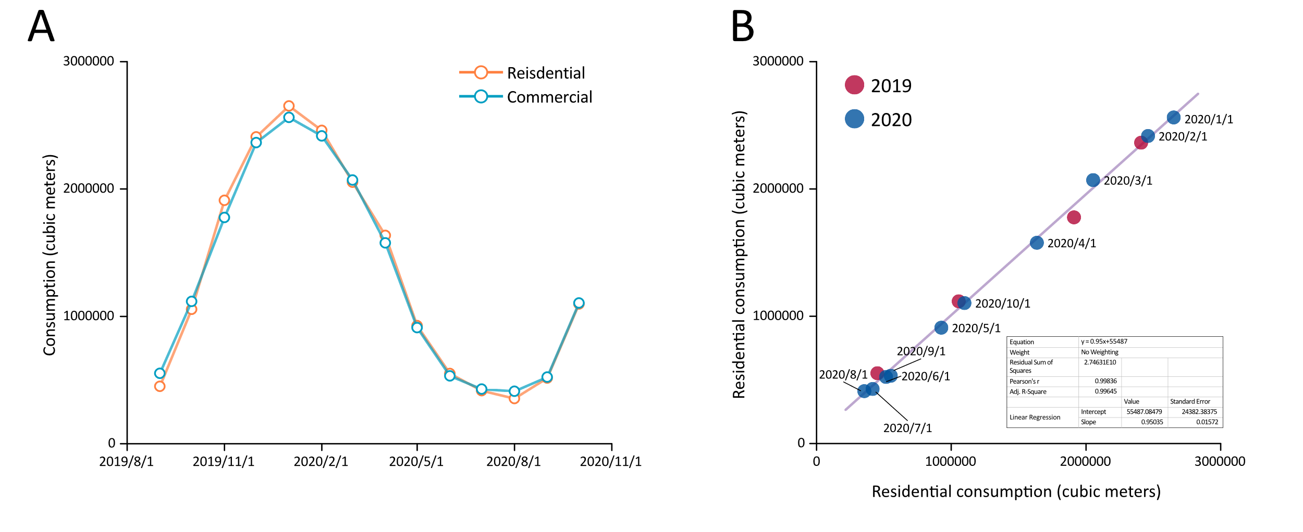
Figure 2: Comparison of residential consumption and commercial consumption (gas).
(A) Commercial and residential consumption from 2019/09 to 2020/10. The blue and orange lines respectively represent residential consumption and commercial consumption of natural gas. (B) Scatter plot of Commercial and residential consumption from 2019/09 to 2020/10. The red circles represent consumption in months in 2019, and blue circles represent consumption by month in 2020. The transparent purple curve is the fitted line generated from linear regression. The details (function, parameters) of the curve is listed in the chart below.
Government of Canada, Statistics Canada. Supply and disposition of natural gas, monthly (data in thousands). Government of Canada, Statistics Canada; 2021. https://doi.org/10.25318/2510005501-eng

Slide 6
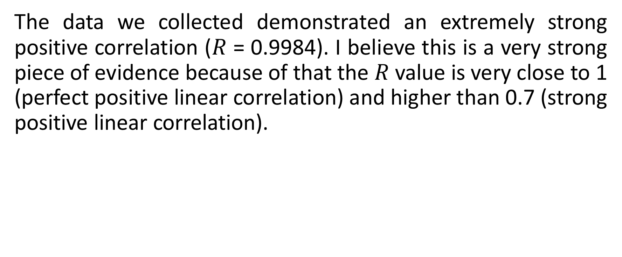
Evaluate the strength
The data we collected demonstrated an extremely strong positive correlation ($R$ = 0.9984). I believe this is a very strong piece of evidence because of that the $R$ value is very close to 1 (perfect positive linear correlation) and higher than 0.7 (strong positive linear correlation).

Slide 7
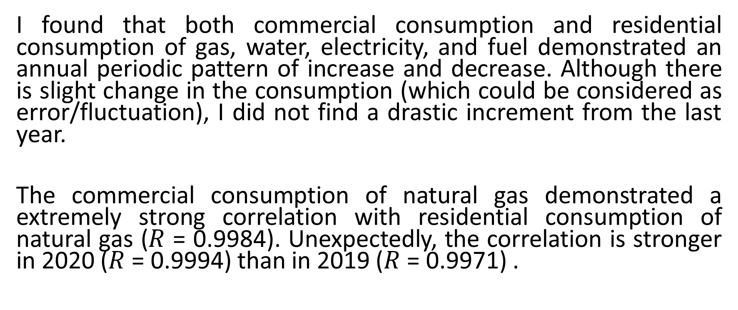
Results & Conclusion
I found that both commercial consumption and residential consumption of gas, water, electricity, and fuel demonstrated an annual periodic pattern of increase and decrease. Although there is slight change in the consumption (which could be considered as error/fluctuation), I did not find a drastic increment from the last year.
The commercial consumption of natural gas demonstrated a extremely strong correlation with residential consumption of natural gas ($R$ = 0.9984). Unexpectedly, the correlation is stronger in 2020 ($R$ = 0.9994) than in 2019 ($R$ = 0.9971) .

Slide 8
Limitations and future research
Our data did not consider the price change of water, fuel, gas, and electricity in Canada. Therefore, the price of these consumptions may vary and therefore the number of resources consumed could be inaccurate.
Secondly, we did not consider the overall trend of the yearly change of both types of consumptions (ie, the annual residential consumption may be increasing at a certain rate).
Multiple relevant studies can be conducted based on my study. I believe that a sensitivity analysis on the prize of the different relevant resources is required before a more thorough, accurate conclusion is drawn.

Slide 9
References
Government of Canada, Statistics Canada. Supply and disposition of natural gas, monthly (data in thousands). Government of Canada, Statistics Canada; 2021. https://doi.org/10.25318/2510005501-eng
Government of Canada, Statistics Canada. Gross domestic product, expenditure-based, Canada, quarterly. Government of Canada, Statistics Canada; 2020 . https://doi.org/10.25318/3610010401-eng

Slide 10
Thank you! Data/Figure available from: https://github.com/blairyeung/Data-ISP-Raw-Data-and-figures

